Slide 1
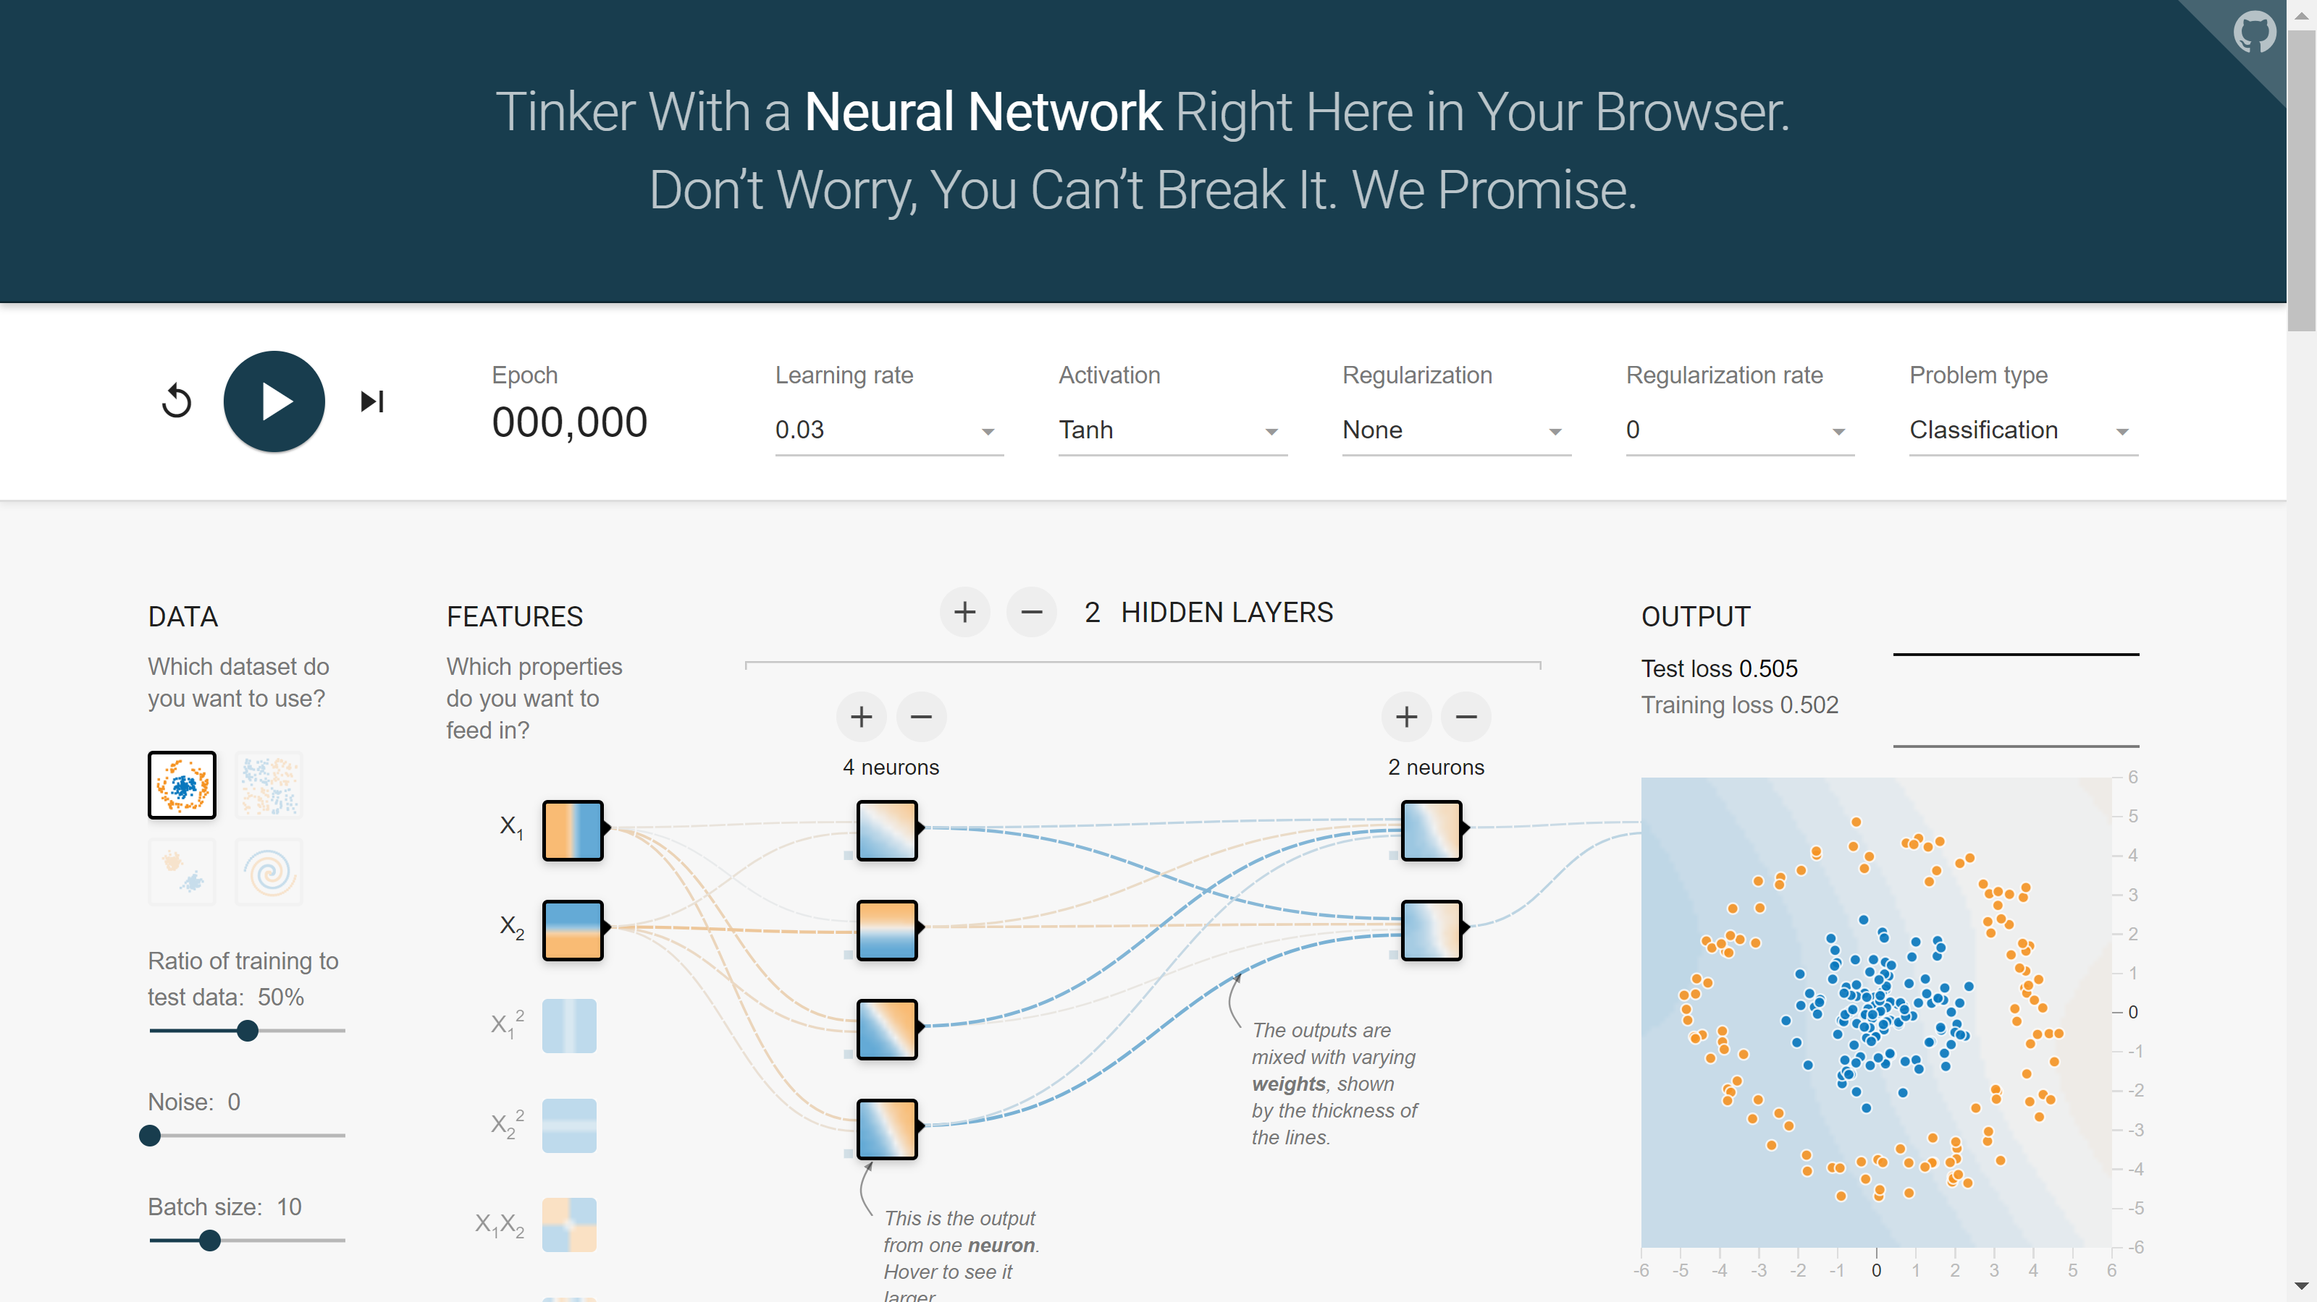
CS5187 Vision and Image: Neural Network

Slide 2
Outline
Deep Learning
  RNN
  CNN
  Attention
  Transformer

Slide 3
RNNs
Some slides borrowed from Fei-Fei Li & Justin Johnson & Serena Yeung at Stanford.

Slide 4
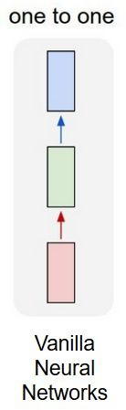
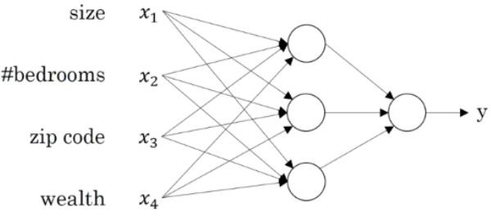
Vanilla Neural Networks
House Price Prediction
Output
Input
Hidden Layers
Hidden Layers
Output
Input

Slide 5
How to model sequences?
Text Classification: Input Sequence -> Output label
Translation: Input Sequence -> Output Sequence
Image Captioning: Input image -> Output Sequence

Slide 6
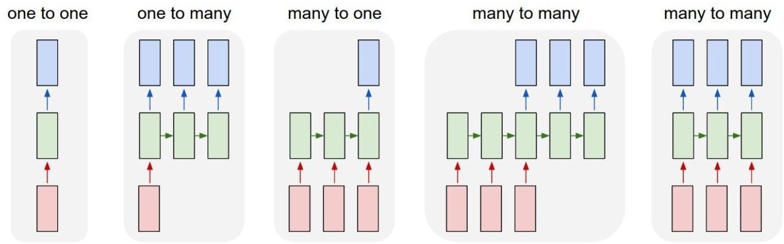
RNN- Recurrent Neural Networks
Vanilla Neural Networks
e.g.- Image Captioning
e.g.- Text Classification
e.g.- Translation
e.g.- POS
tagging

Slide 7
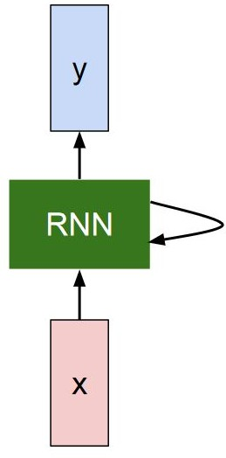
RNN- Representation
Output Vector
Hidden state fed back into the RNN cell
Input Vector

Slide 8
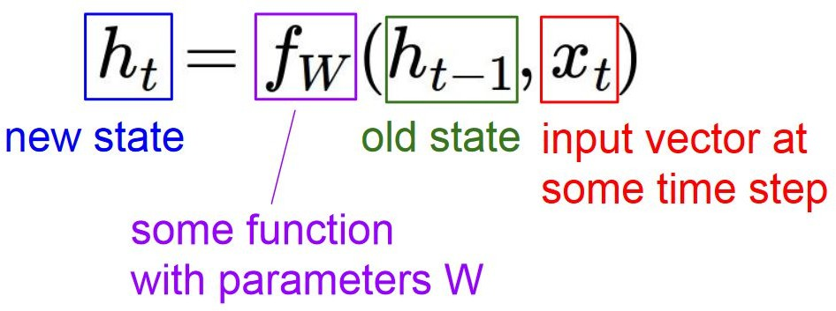
RNN- Recurrence Relation
The RNN cell consists of a hidden state that is updated whenever a new input is received. At every time step, this hidden state is fed back into the RNN cell.
Output Vector
Hidden state fed back into the RNN cell
Input Vector

Slide 9
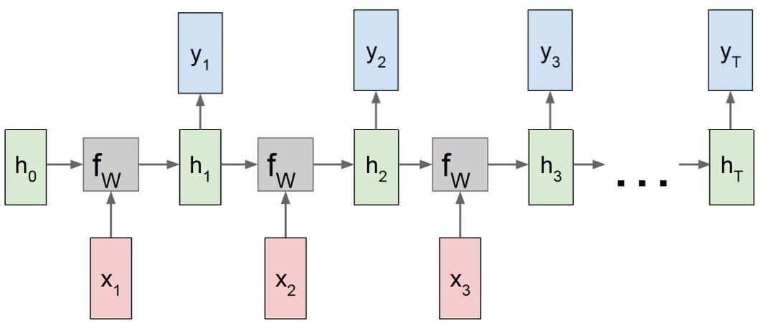
RNN- Rolled out representation

Slide 10
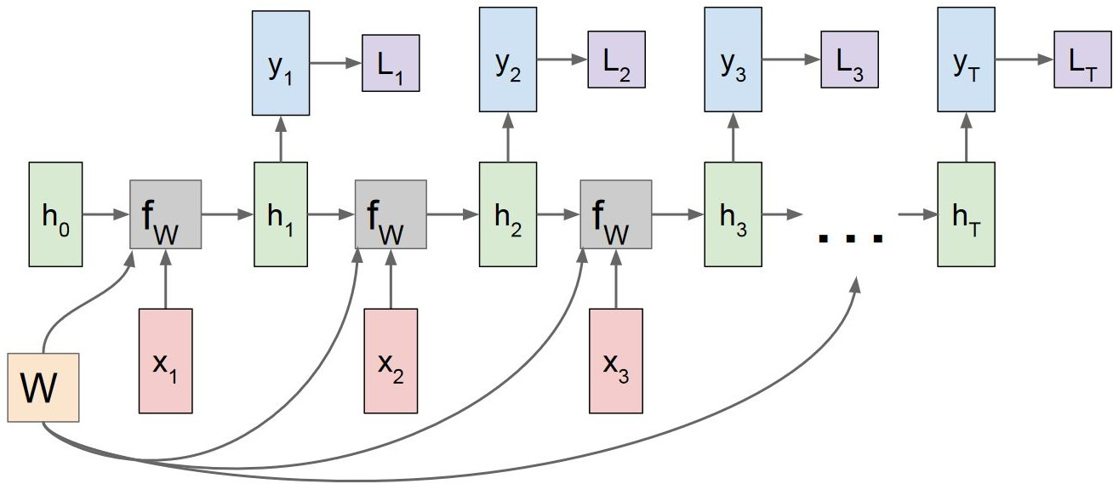
RNN- Rolled out representation
Individual Losses Li
Same Weight matrix- W

Slide 11
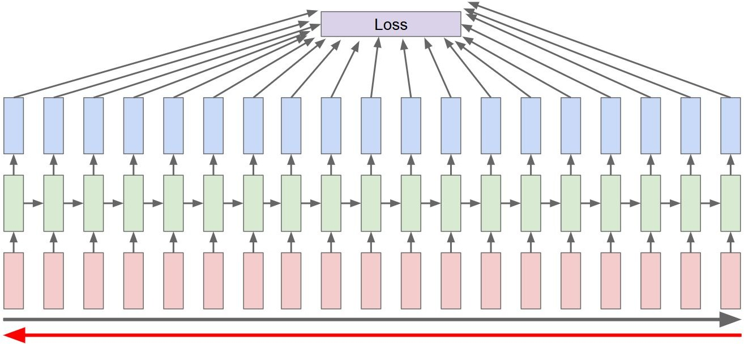
RNN- Backpropagation Through Time
Forward pass through entire sequence to produce intermediate hidden states, output sequence and finally the loss. Backward pass through the entire sequence to compute gradient.

Slide 12
RNN- Backpropagation Through Time
Running Backpropagation through time for the entire text would be very slow. Switch to an approximation- Truncated Backpropagation Through Time

Slide 13
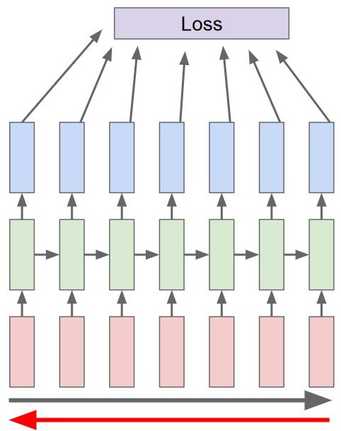
RNN- Truncated Backpropagation Through Time
Run forward and backward through chunks of the sequence instead of whole sequence

Slide 14
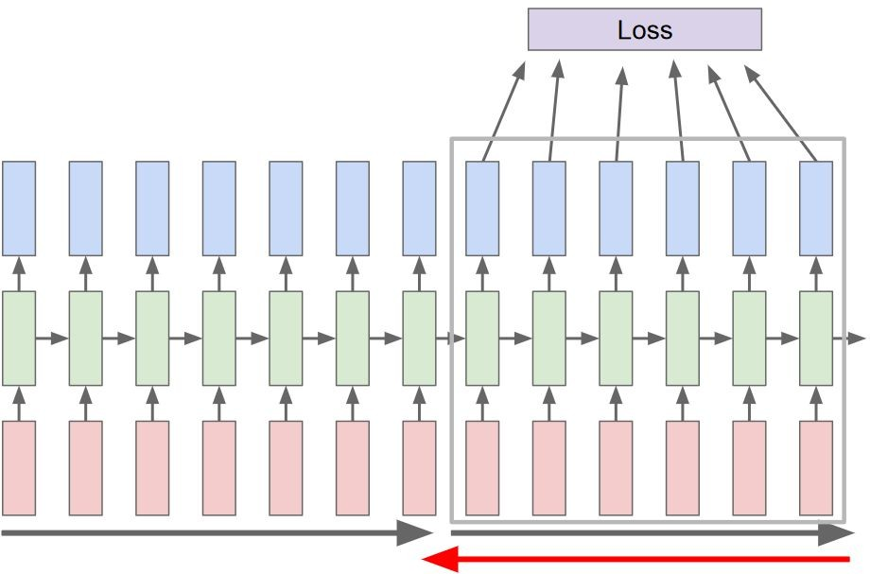
RNN- Truncated Backpropagation Through Time
Carry hidden states forward in time forever, but only backpropagate for some smaller number of steps

Slide 15
RNN- Types
The 3 most common types of Recurrent Neural Networks are-
Vanilla RNN
LSTM (Long Short-Term Memory)
GRU (Gated Recurrent Units)
Some good resources- Understanding LSTM Networks
An Empirical Exploration of Recurrent Network Architectures
Recurrent Neural Network Tutorial, Part 4 – Implementing a GRU/LSTM RNN with Python and Theano Stanford CS231n: Lecture 10 | Recurrent Neural Networks

Slide 16
CNNs
Some slides borrowed from Fei-Fei Li & Justin Johnson & Serena Yeung at Stanford.

Slide 17
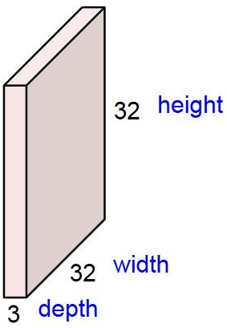
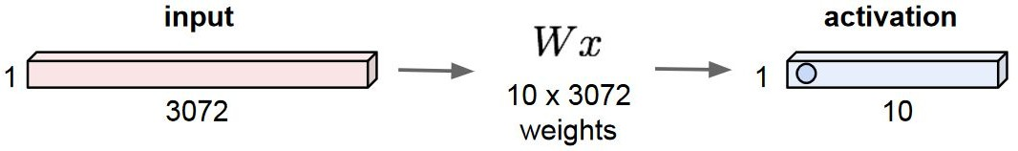
Fully Connected Layer
Input 32x32x3 image
Flattened image 32*32*3 = 3072
Weight Matrix
Output

Slide 18

Convolutional Layer
Input 32x32x3 image
Convolve the filter with the image i.e. “slide over the image spatially, computing dot products”
Filter 5x5x3
Filters always extend the full depth of the input volume.

Slide 19
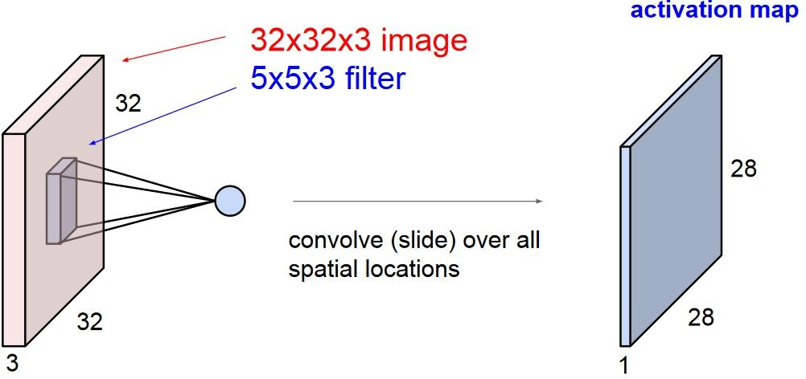
Convolutional Layer
At each step during the convolution, the filter acts on a region in the input image and results in a single number as output.
This number is the result of the dot product between the values in the filter and the values in the 5x5x3 chunk in the image that the filter acts on.
Combining these together for the entire image results in the activation map.

Slide 20
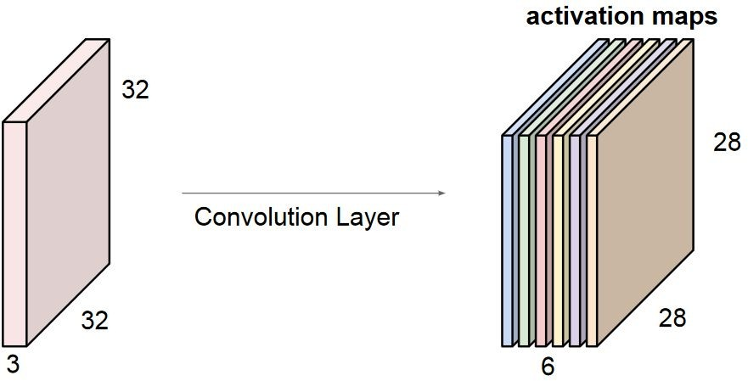
Convolutional Layer
Filters can be stacked together.
Example- If we had 6 filters of shape 5x5,
each would produce an activation map of 28x28x1 and our output would be a “new image” of shape 28x28x6.

Slide 21
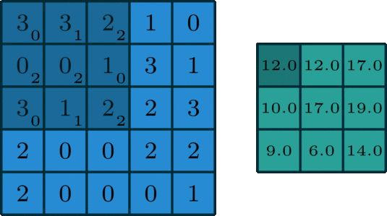
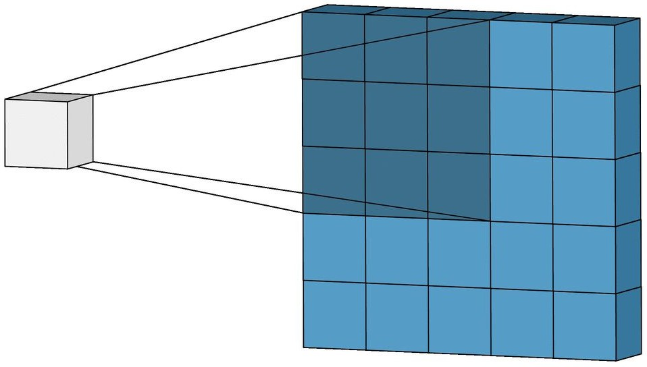
Convolutional Layer
Visualizations borrowed from Irhum Shafkat’s blog.

Slide 22
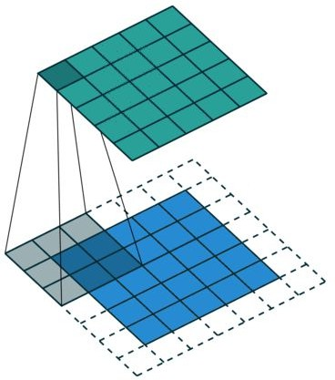
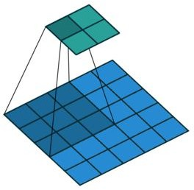
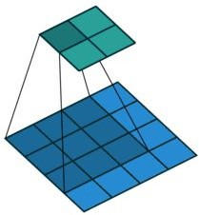
Convolutional Layer
Standard Convolution
Convolution with Padding
Convolution with strides
Visualizations borrowed from vdumoulin’s github repo.

Slide 23
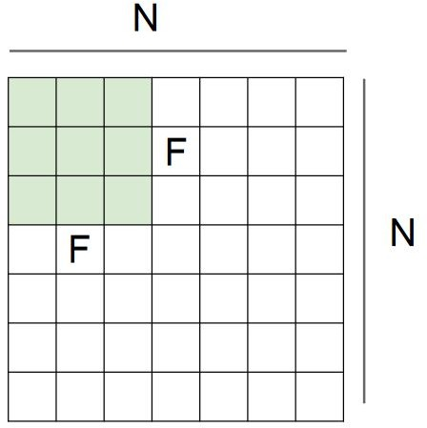
Convolutional Layer
Output Size:
(N - F)/stride + 1
e.g. N = 7, F = 3, stride 1
=> (7 - 3)/1 + 1 = 5
e.g. N = 7, F = 3, stride 2
=> (7 - 3)/2 + 1 = 3

Slide 24
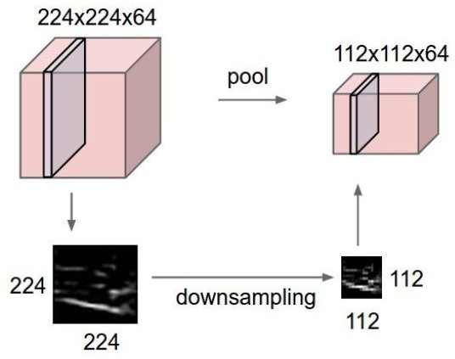
Pooling Layer
makes the representations smaller and more manageable
operates over each activation map independently

Slide 25
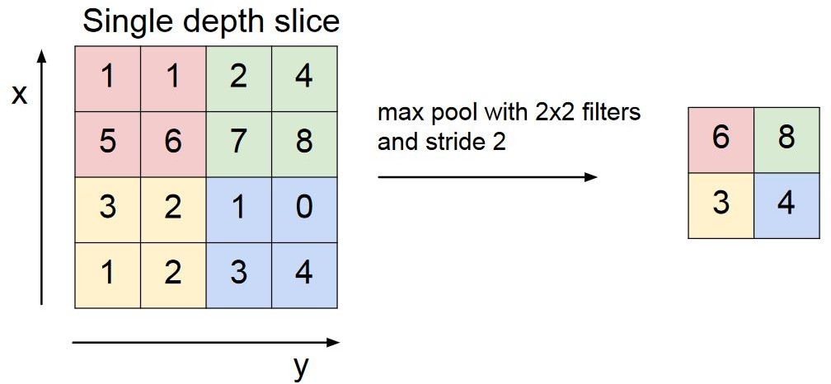
Max Pooling

Slide 26
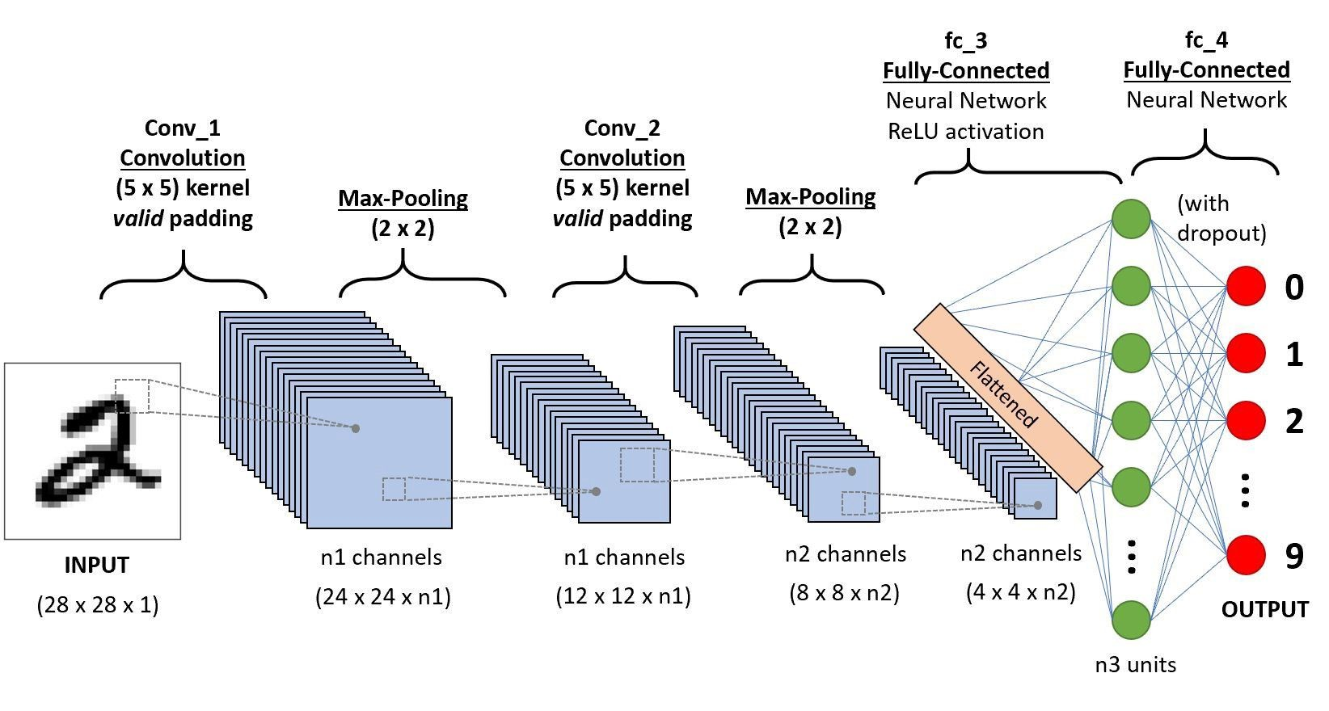
ConvNet Layer
Image credits- Saha’s blog.

Slide 27
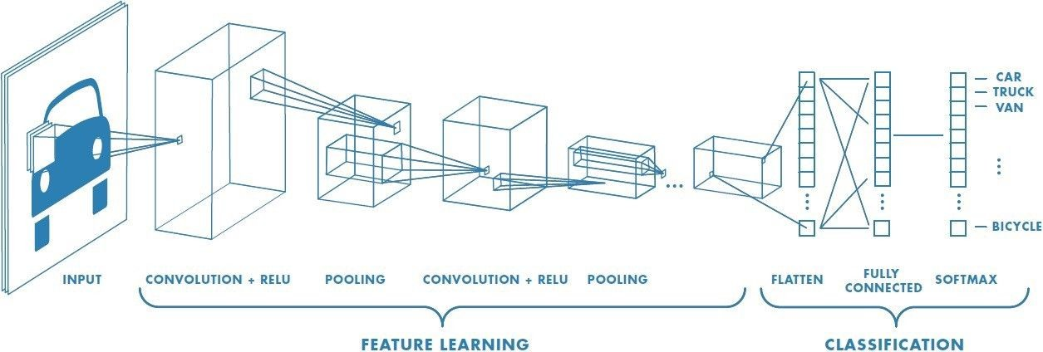
ConvNet Layer
Image credits- Saha’s blog.

Slide 28
Attention
Some slides borrowed from Sarah Wiegreffe at Georgia Tech.

Slide 29
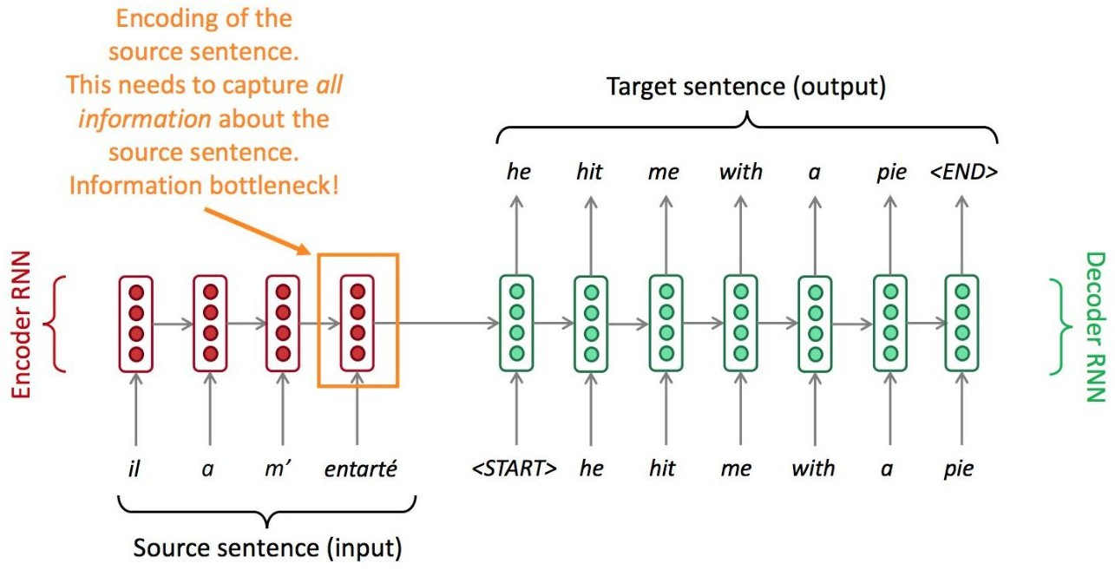
RNN

Slide 30
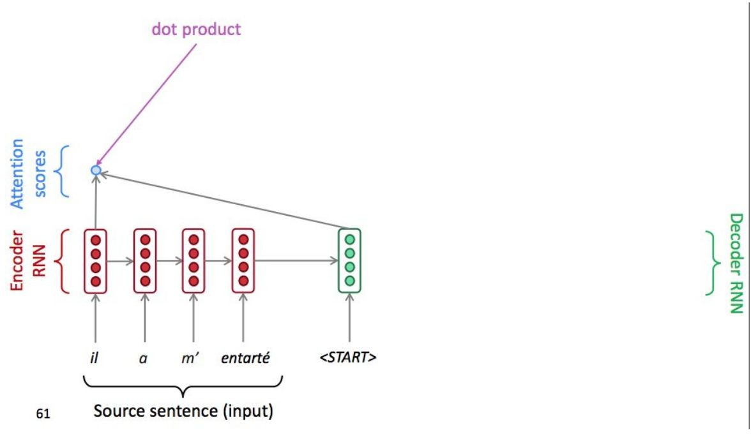
RNN - Attention

Slide 31
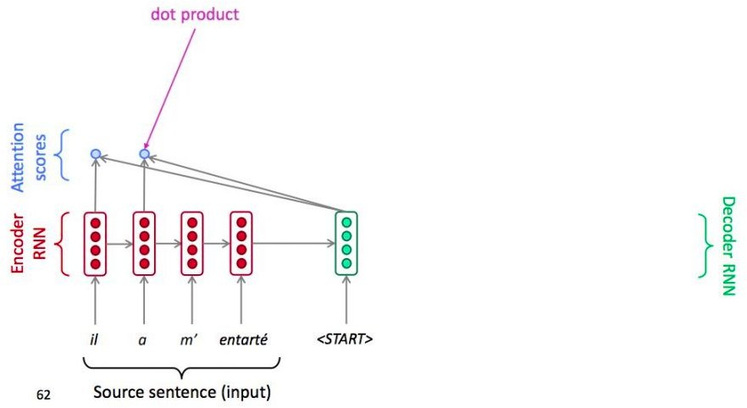
RNN - Attention

Slide 32
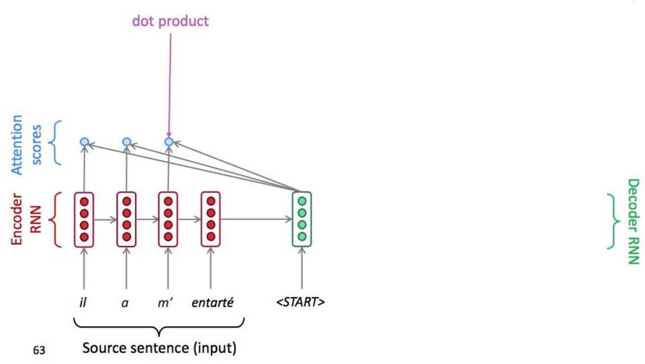
RNN - Attention

Slide 33
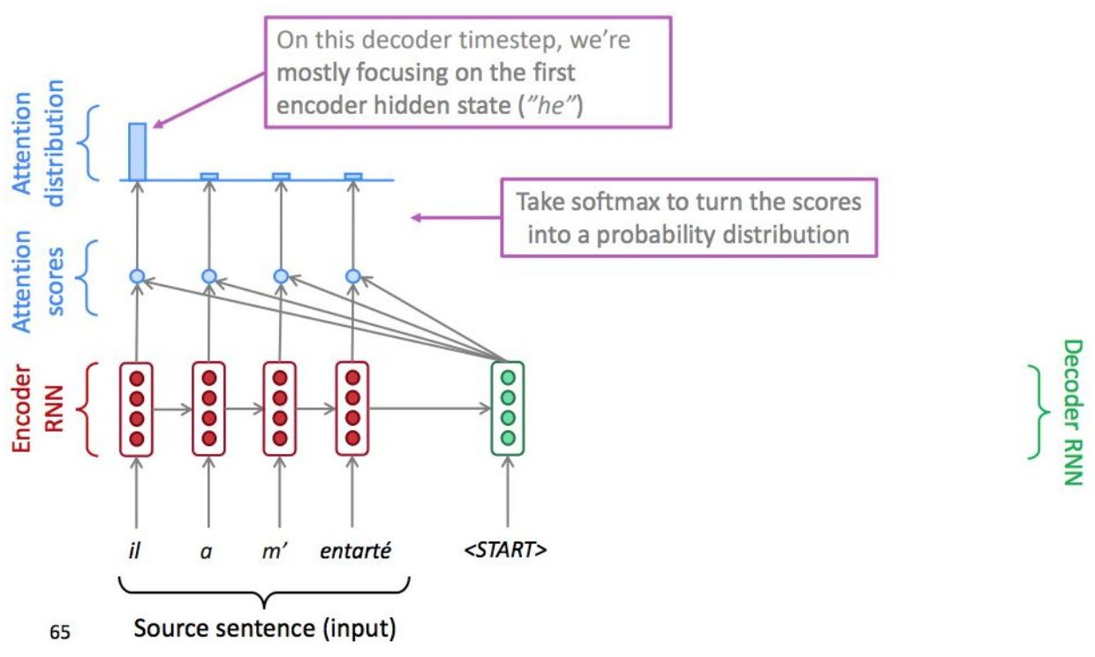
RNN - Attention

Slide 34
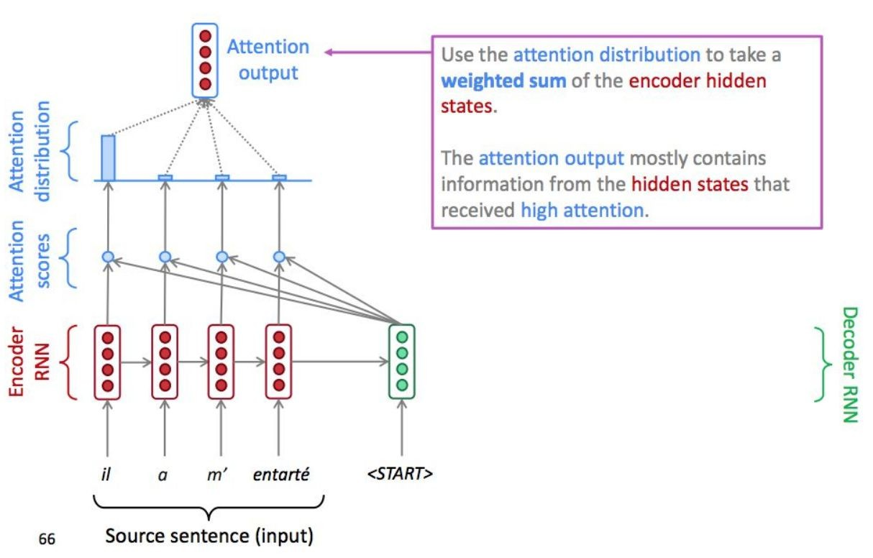
RNN - Attention

Slide 35
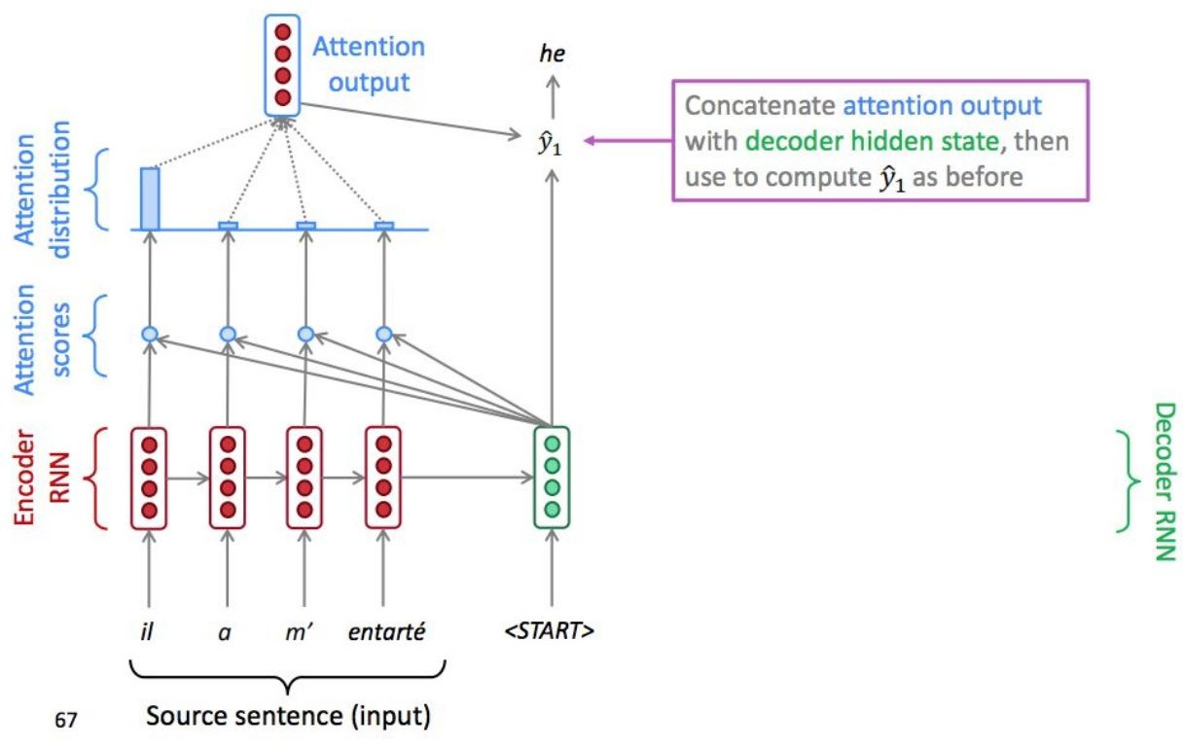
RNN - Attention

Slide 36
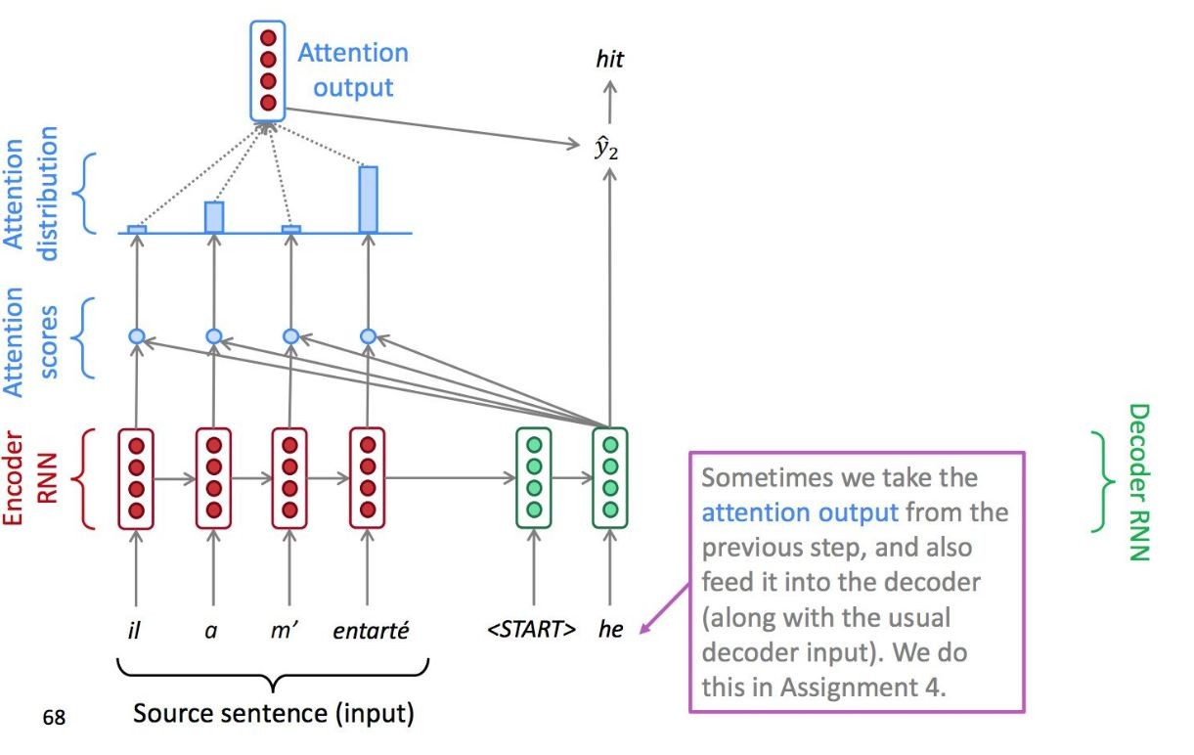
RNN - Attention

Slide 37
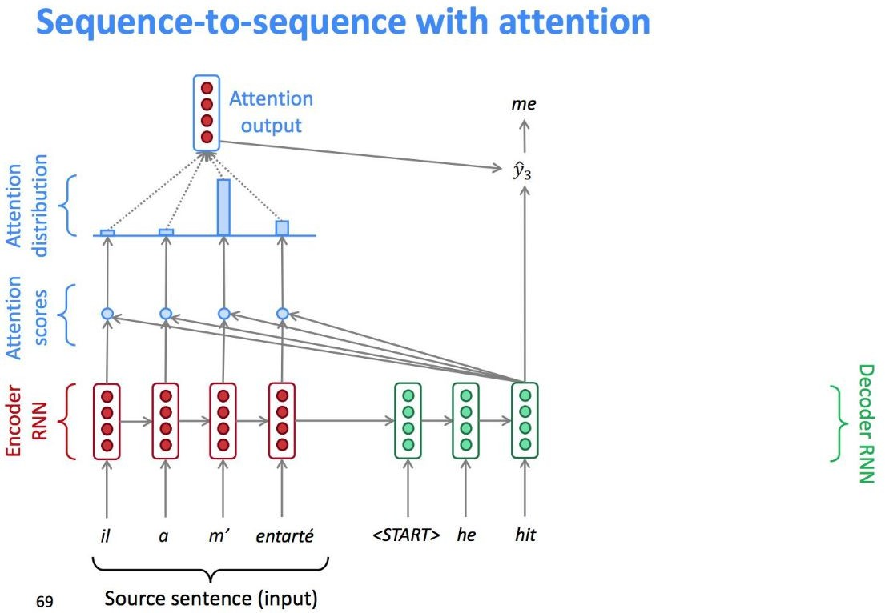
RNN - Attention

Slide 38
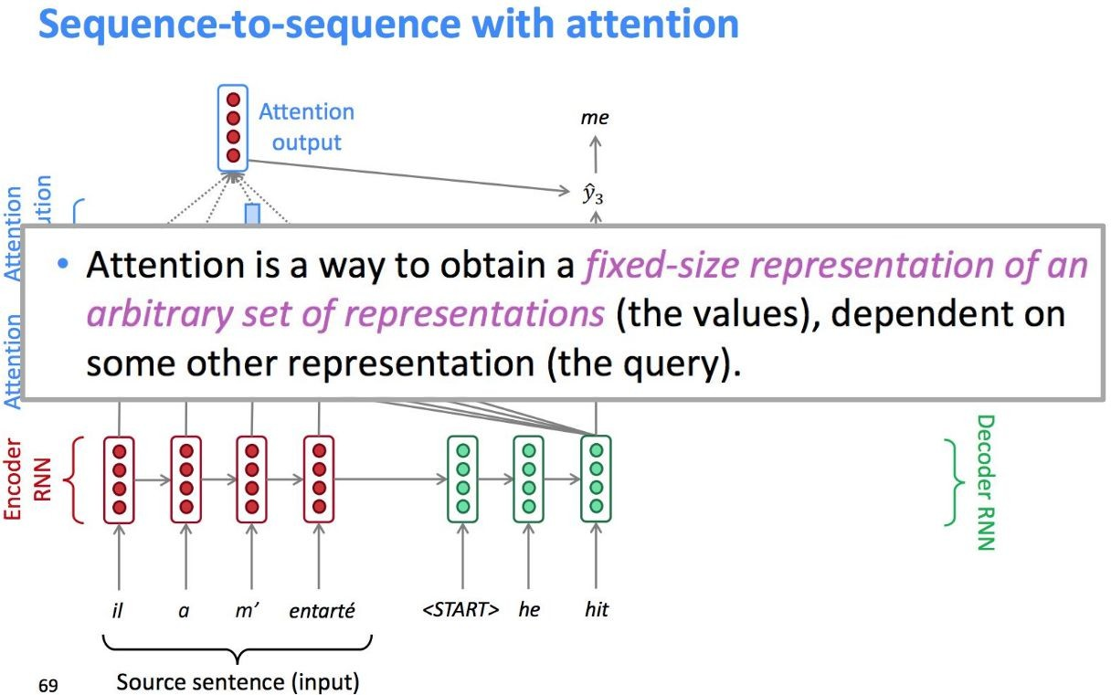
RNN - Attention

Slide 39
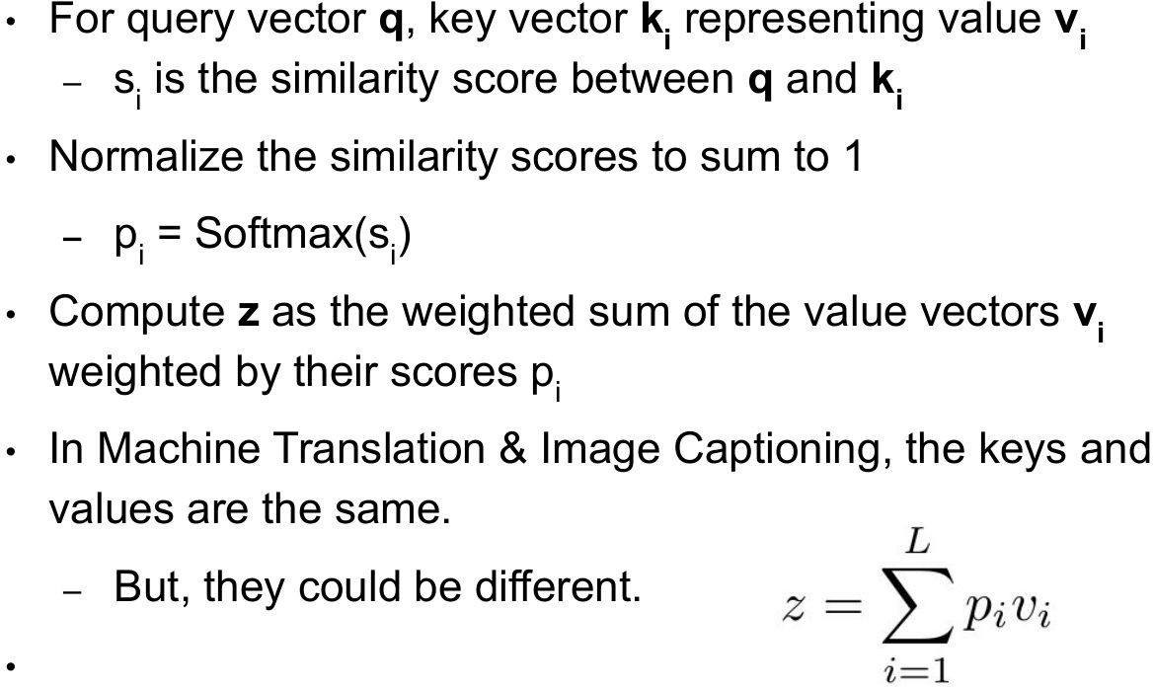
Attention

Slide 40
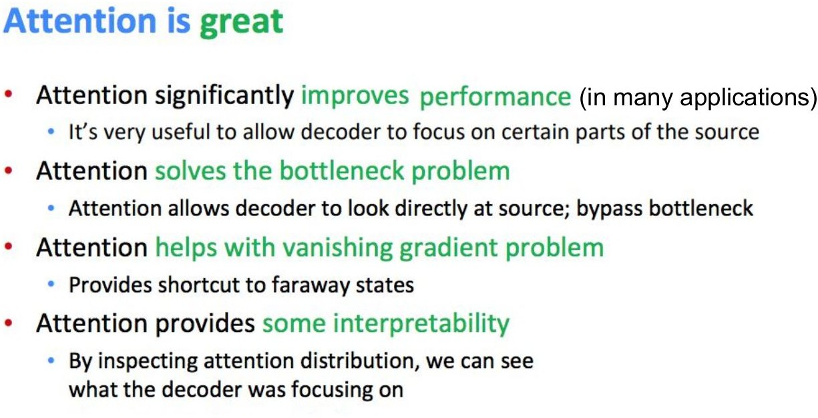

Slide 41
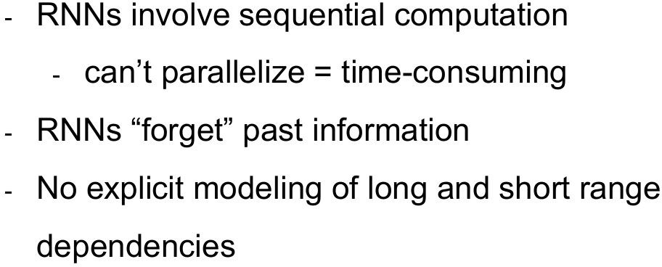
Drawbacks of RNN

Slide 42
Transformer
Some slides borrowed from Sarah Wiegreffe at Georgia Tech.

Slide 43
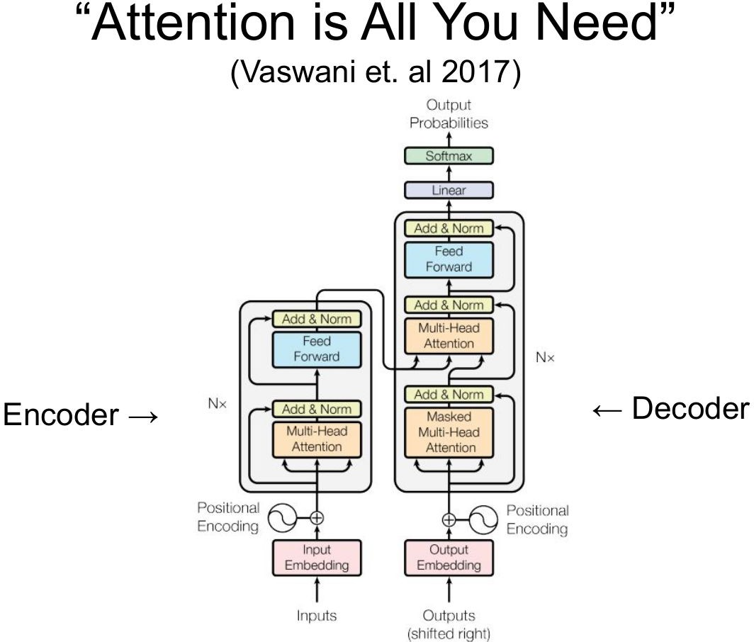
Transformer

Slide 44
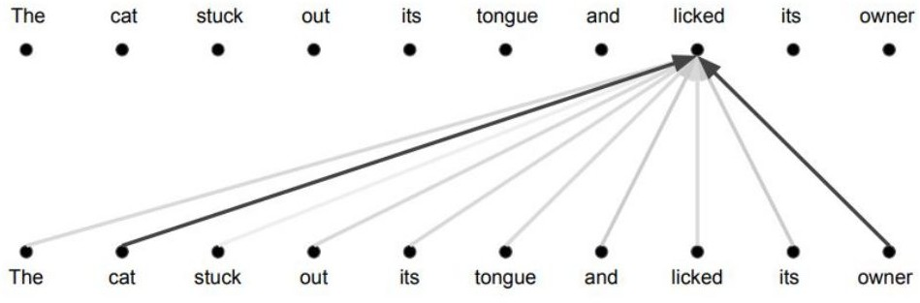
Self-Attention

Slide 45
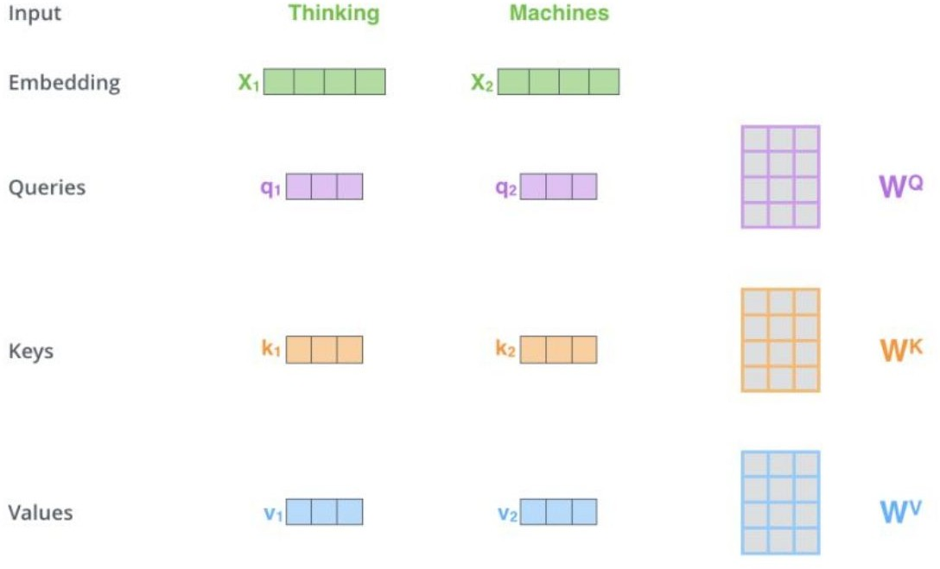
Self-Attention

Slide 46
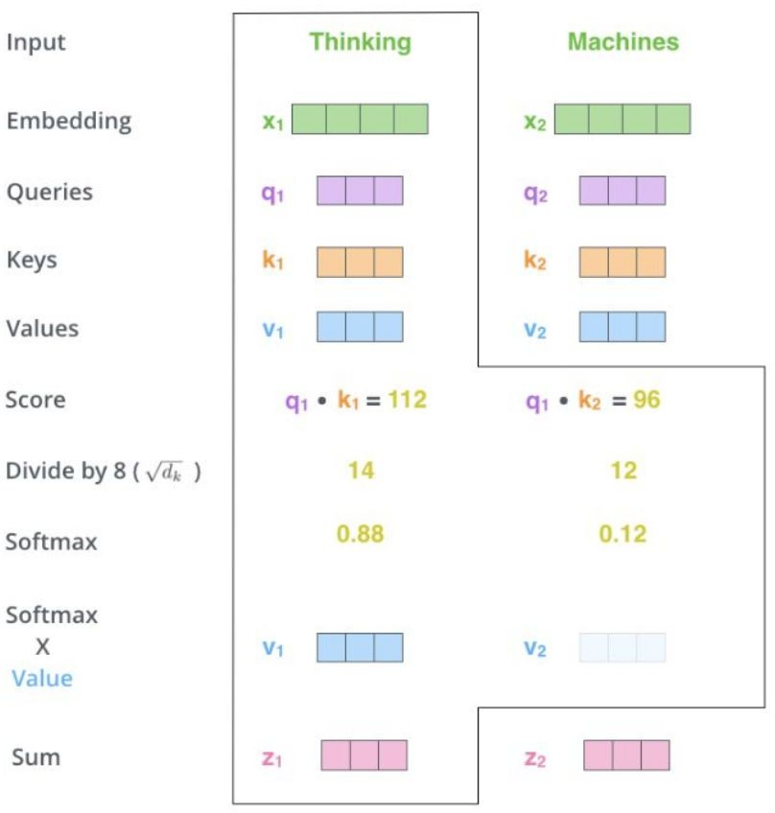
Self-Attention

Slide 47
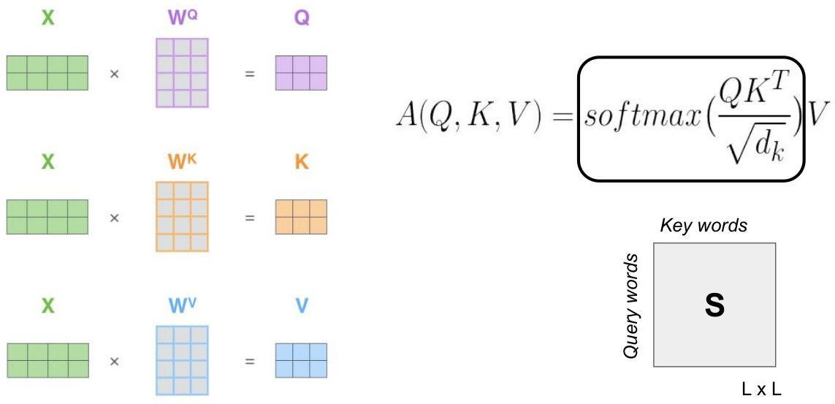
Self-Attention

Slide 48
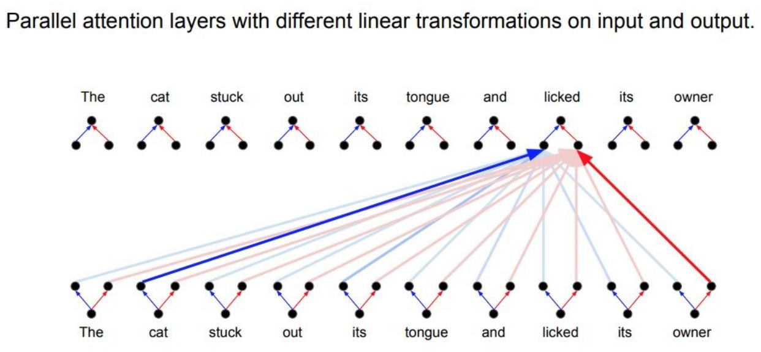
Multi-Head Self-Attention

Slide 49
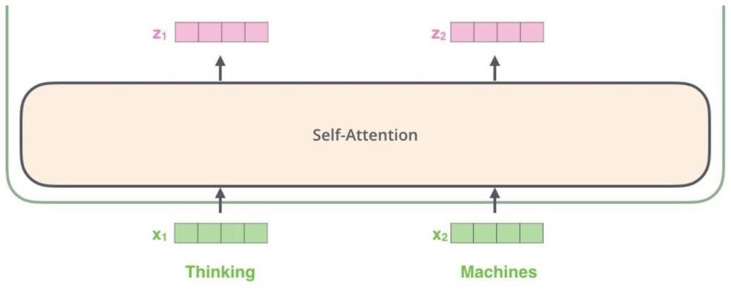
Retaining Hidden State Size

Slide 50
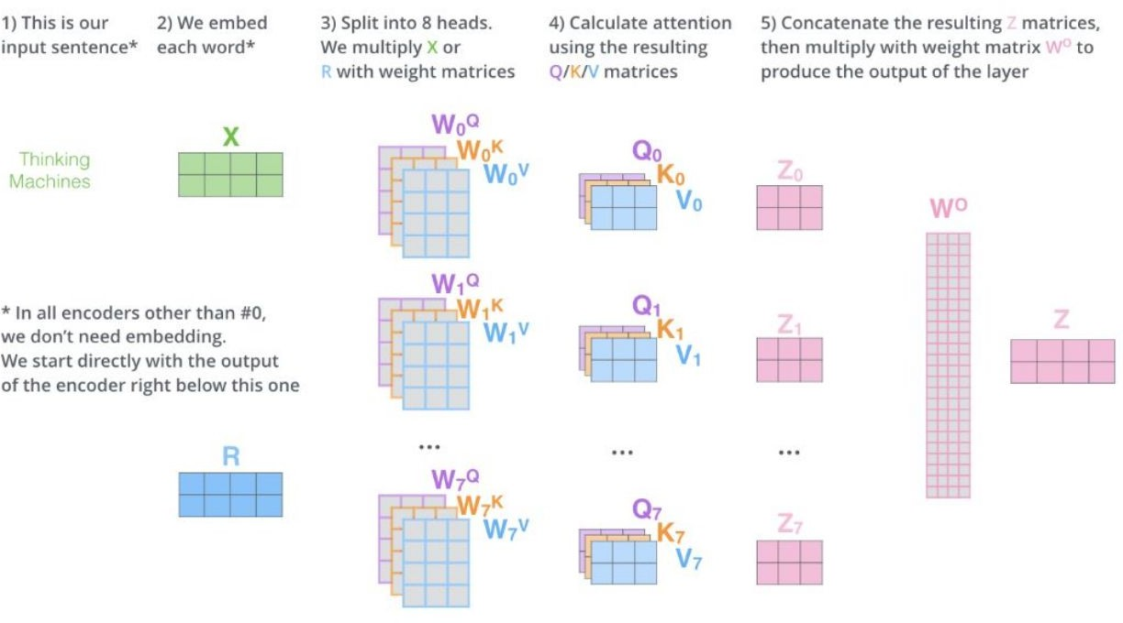
Details of Each Attention Sub-Layer of Transformer Encoder

Slide 51
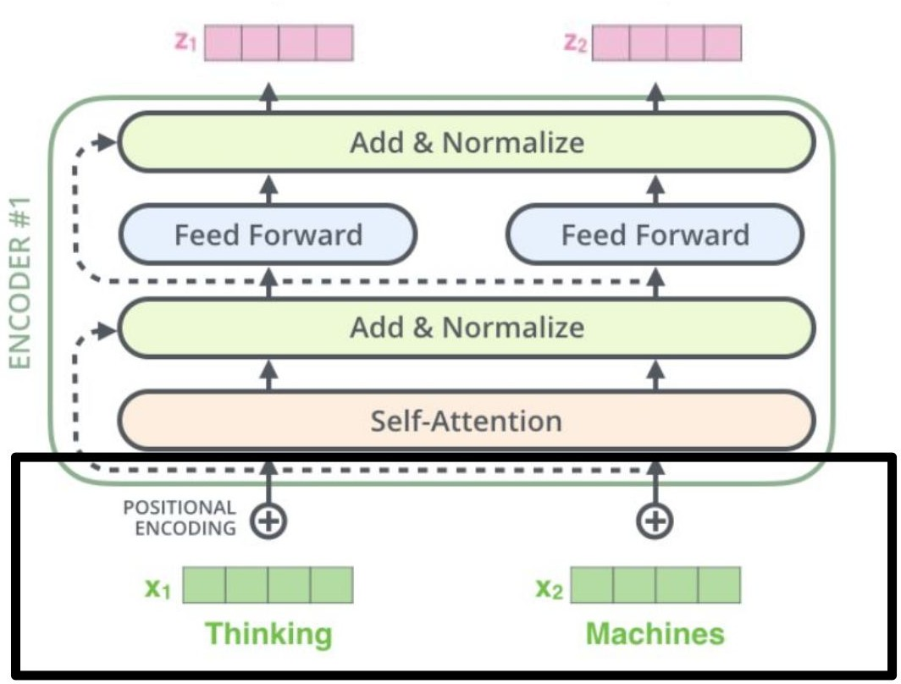
Each Layer of Transformer Encoder

Slide 52
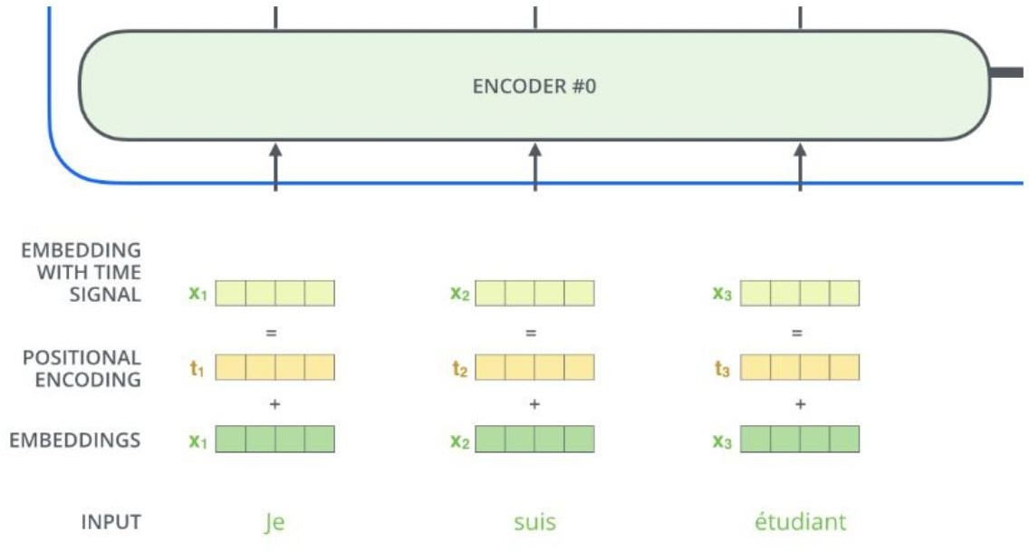
Positional Encoding

Slide 53
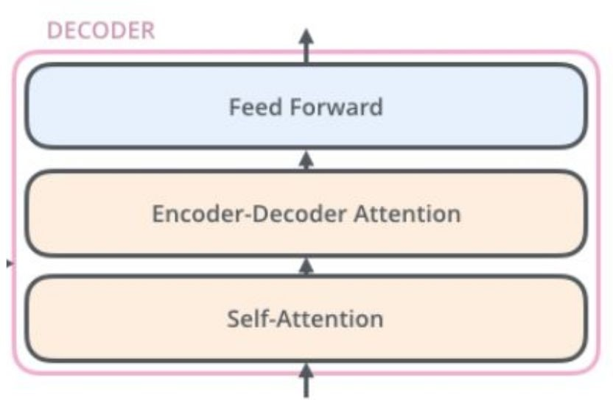
Each Layer of Transformer Decoder

Slide 54
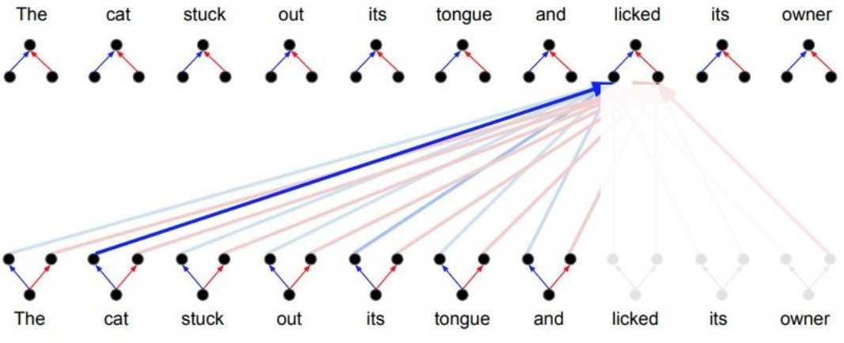
Transformer Decoder - Masked Multi-Head Attention
Problem of Encoder self-attention: we can’t see the future !

Slide 55
Transformer

